Slide 1


Slide 2
ZOMATO DATASET PROBLEM STATEMENT
Restaurants from all over the world can be found here in Bengaluru. Bengaluru is the best place for foodies. The number of restaurants is increasing day by day. Currently, it stands at approximately 12,000 restaurants. t. And new restaurants are opening every day. However, it has become difficult for them to compete with already established restaurants
OBJECTIVE
The newly started companies are not able to decide the cost that would happen per two people for once. So the Zomato company has a good analyst team who can predict the cost per two customers for one time so that the newly started restaurants and upcoming restaurants will be well prepared how the restaurant should invest in improving the ambiance and all other stuff to attract the customers.

Slide 3
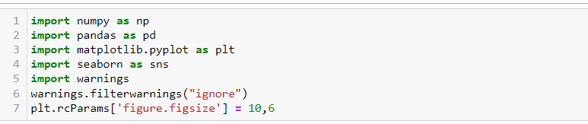
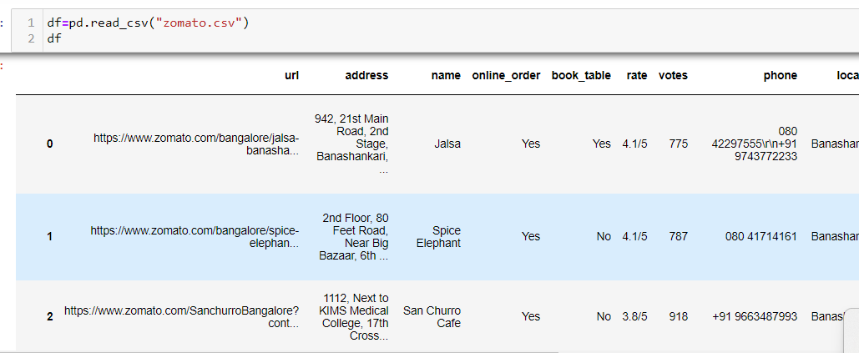
We are firstly importing the required libraries
Next, we are reading the csv file of the data set

Slide 4
Data Description
1.URL - Website of the Zomato for each restaurant. - Object datatype
2. Address - Address of the Restaurant. - Object datatype
3. Name - Name of the restaurant. - Object datatype
4. Online Order - The customer ordered the menu online or not. - Object datatype
5. Book table - The customer has booked the table or not. - Object datatype
6. Rate - Rating of the restaurant that has by the customer. - Numerical datatype
7. Votes - The votes have been given by the customer to the restaurant. - Numerical datatype
8. Phone - Contact number of the Restaurant. - Object datatype
9. Location - The city name where the restaurant is located. - Object datatype
10. Rest Type - The type of restaurant. - Object datatype
11. Dish liked - Dishes liked by the customer from the restaurant. - Object datatype
12. Cuisines - The cuisines that have been prepared by the restaurant. - Object datatype
13. Approx -Cost for two people - The approximate cost of the customer for 2 people. -Number datatype
14. Reviews list - The reviews made by the customers on the restaurant. - Object datatype
15. Menu Item - The menu items that are usually available at the restaurant. - Object datatype
16. Listed in (type) - Contains the type of the meal. - Object datatype
17. Listed in (city) - This contains the neighborhood in which the restaurant is listed. -Object datatype

Slide 5
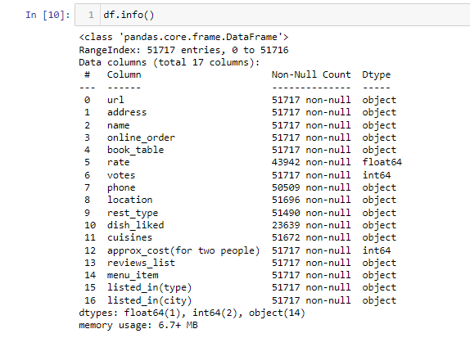

Make the data proper to make use of data for analysis
Identify the Features data types and shape of the dataset
There 14 categorical columns and 3 numerical columns

Slide 6
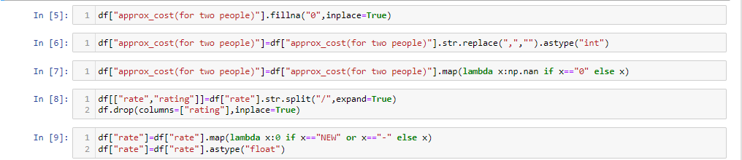
Make the data proper to make use of data for analysis
The variable approximate cost which has the missing values which is filled with fillna.
And it’s datatype is changed to numeric, since the continuous values
were present in the column.
The variable rate which is separated into rating out of 5 and changed to
numeric.

Slide 7
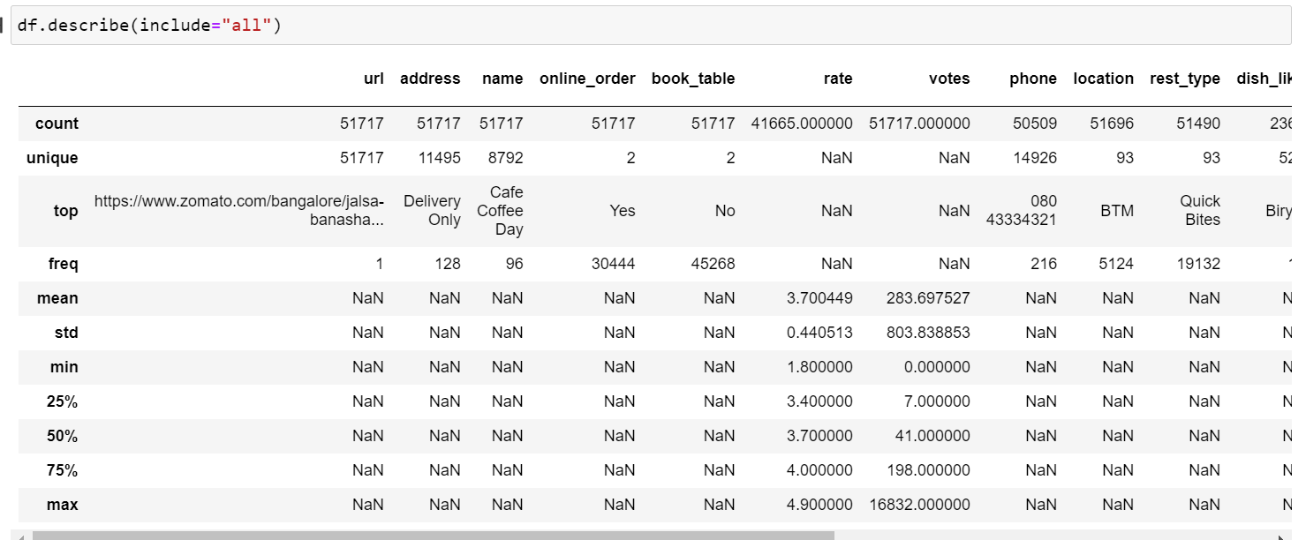
Descriptive Statistics:
URL has all unique variables.
Cafe Coffee Day has the highest number of outlets(96).
Many people order online which is about 30444(58.8%).
Many restaurants are based out of BTM layout of about 5124(10%).
Majority of the listed restaurants provide delivery of about 25942(50.16%).

Slide 8
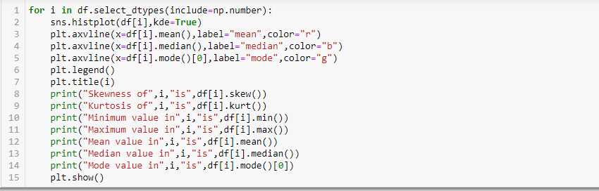
Univariate and Bivariate Analysis
Here we are using histplot from seaborn to check the distribution of the data.

Slide 9
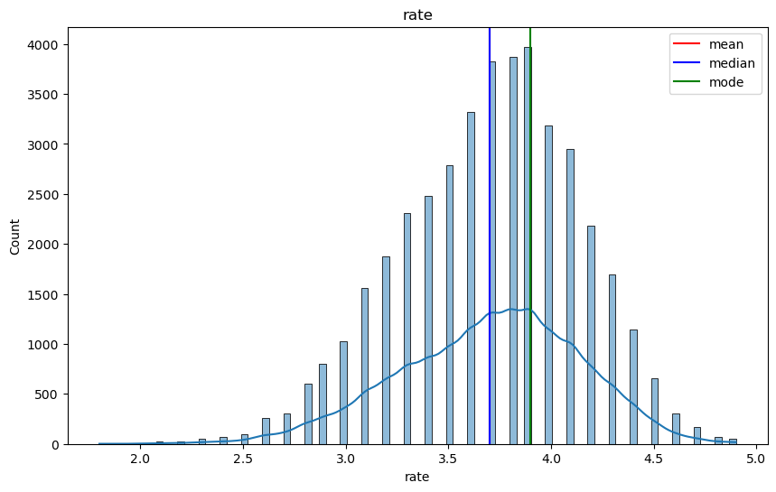
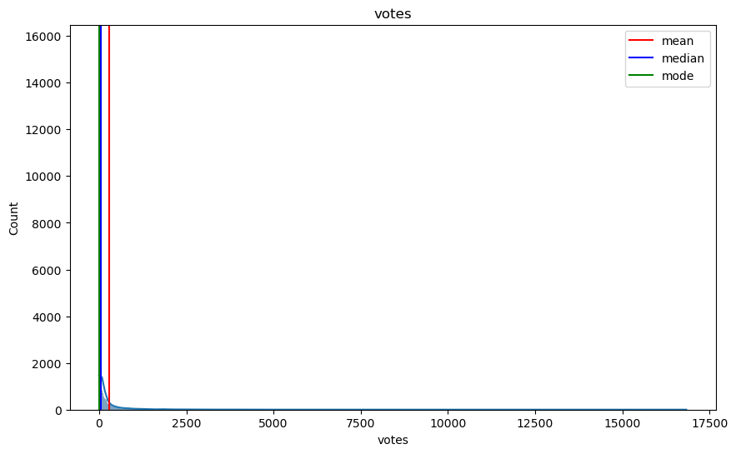
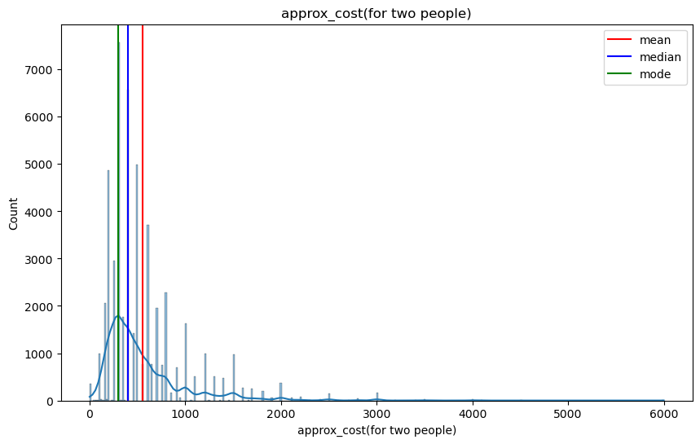
We have 3 numerical features
From the analysis we can identify the skewness, kurtosis, minimum value, maximum value, mean, median and mode.

Slide 10

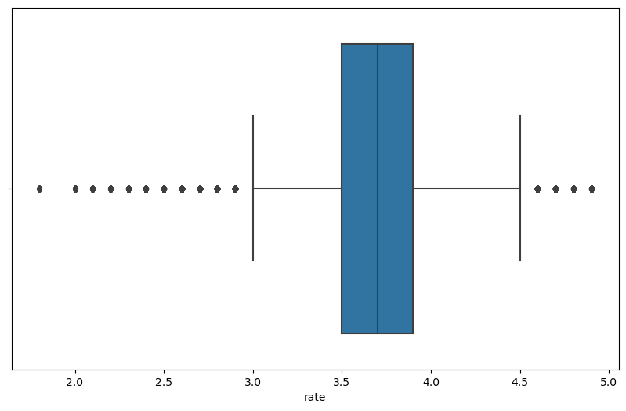
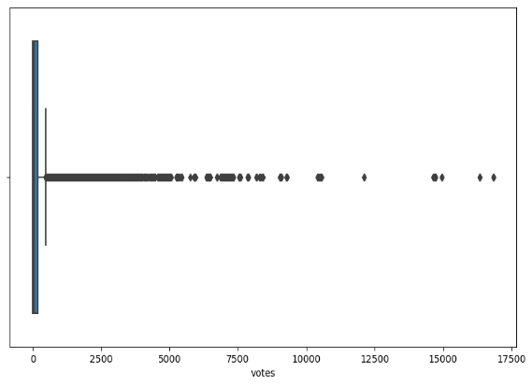
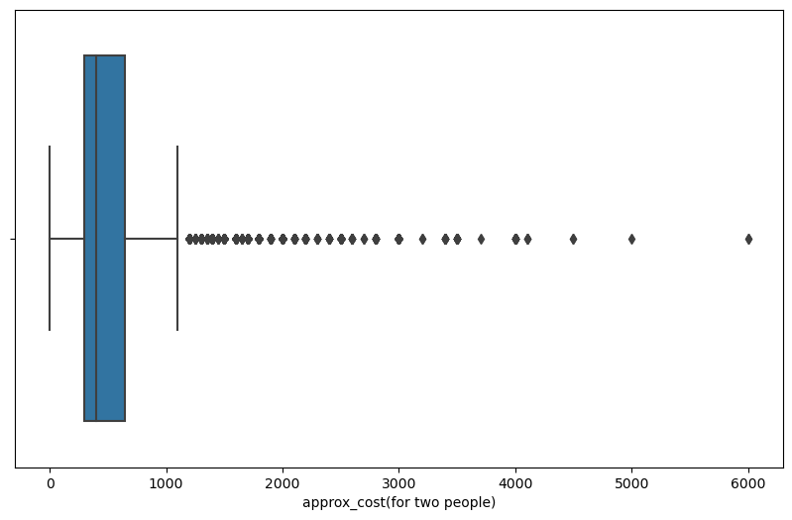
Outliers:
Here we used boxplot to identify the outliers which is present in the data.
The variables rate, votes and approx. cost

Slide 11
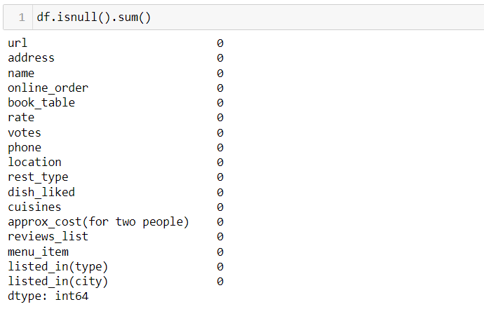
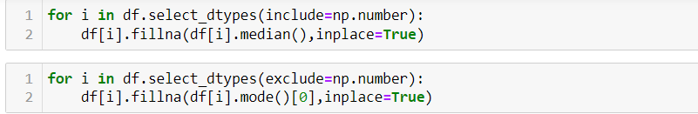
Missing Values and it’s treatment:
Here have imputed the missing values with fillna using median and mode.

Slide 12
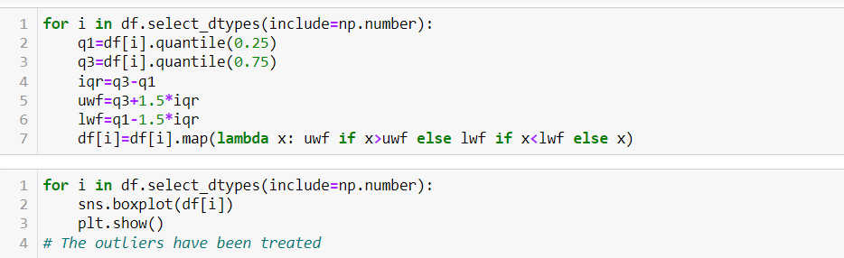
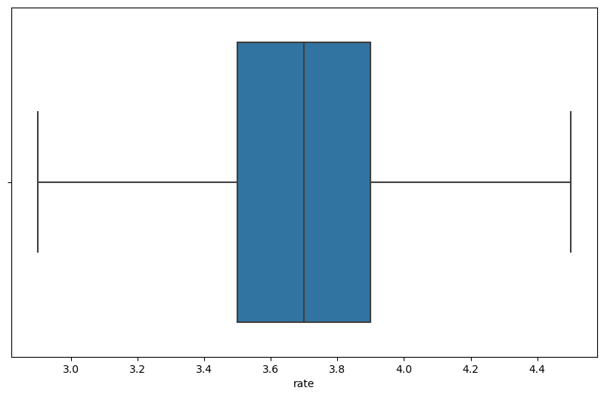
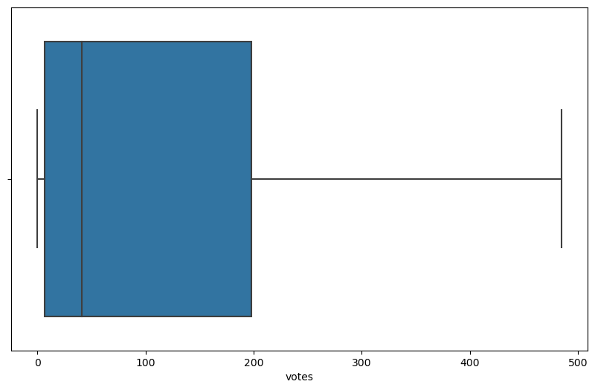
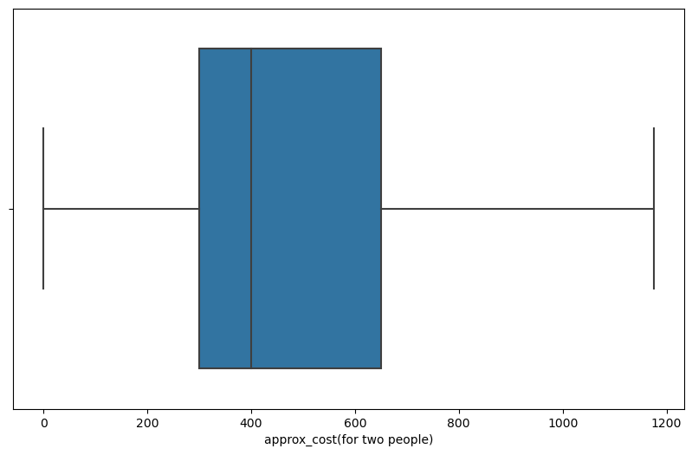
Outliers and its treatment:
Treating outliers with Inter Quantile range method

Slide 13
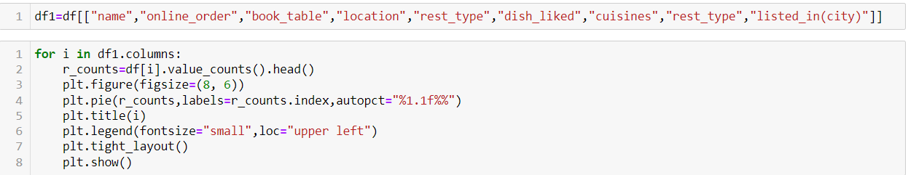
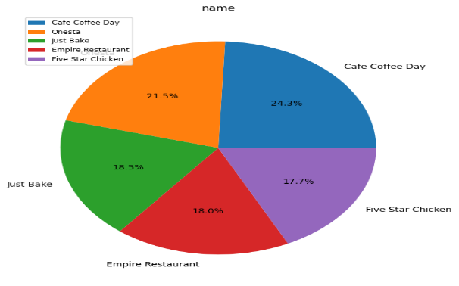
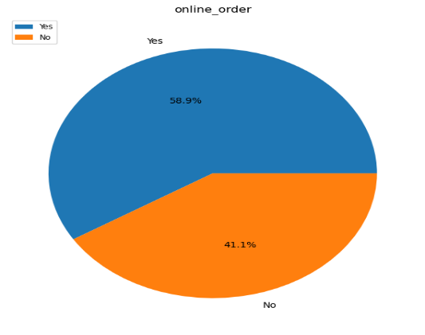
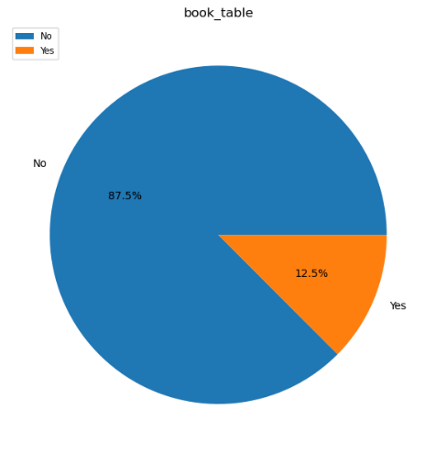
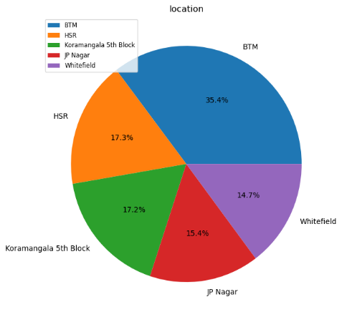
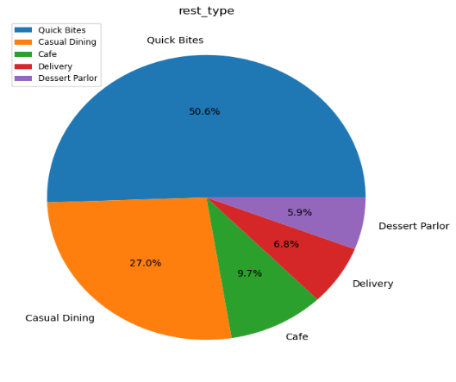
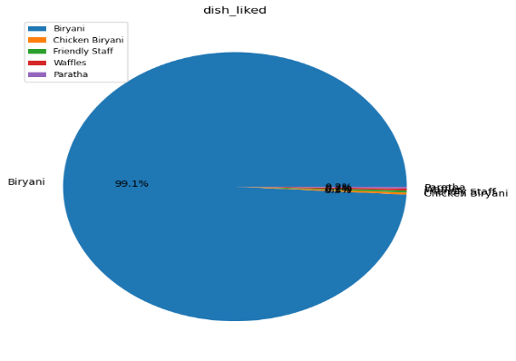
Univariate Analysis

Slide 14
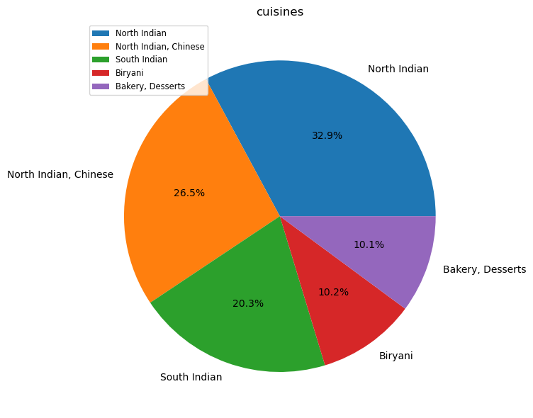

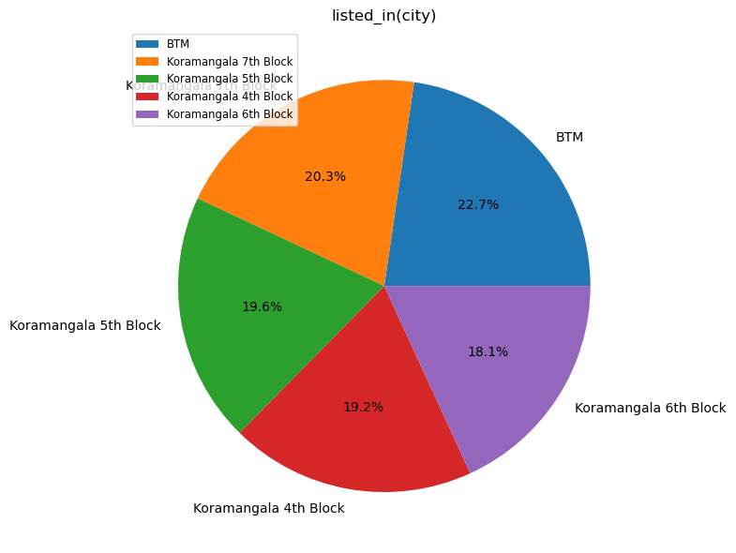
The values which are represented using pie chart from the different categories of variables.
It is based on the name, online order, book table, location, rest types etc.

Slide 15
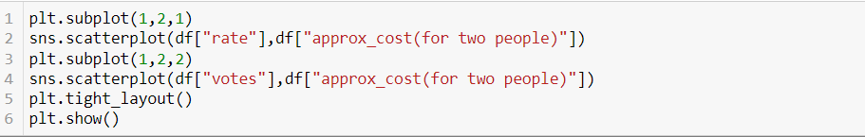
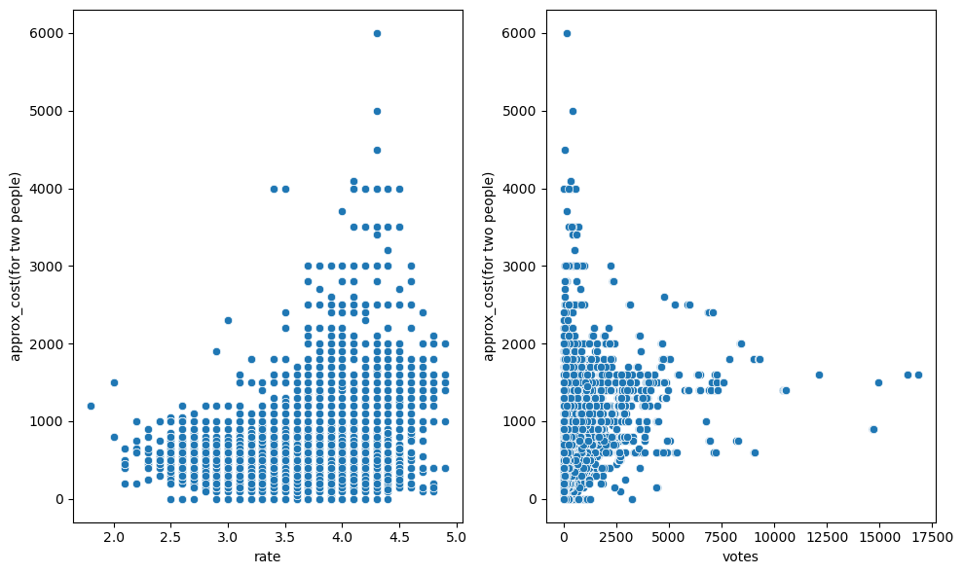
Bivariate Analysis:
The variables which have relation between the dependent variables is shown within the scatter plot using subplots.

Slide 16
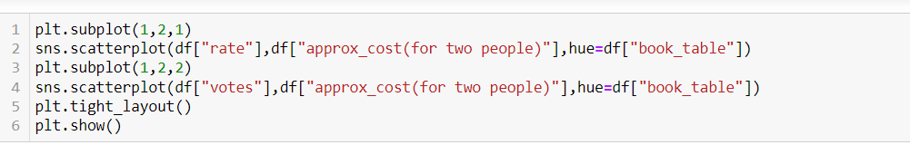
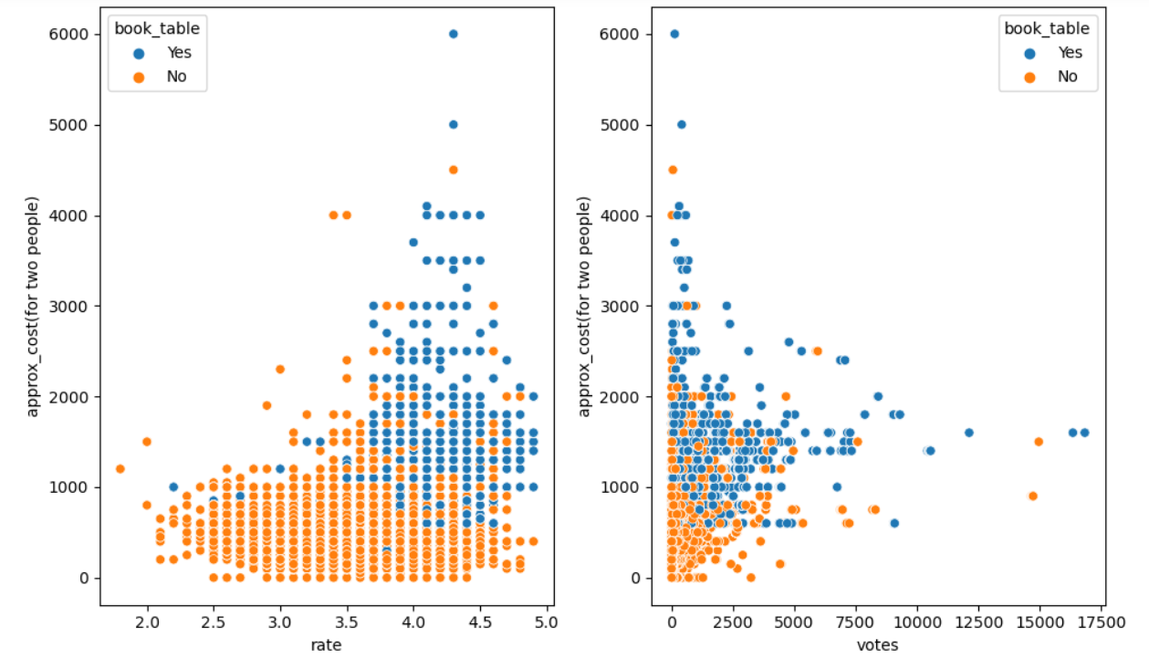
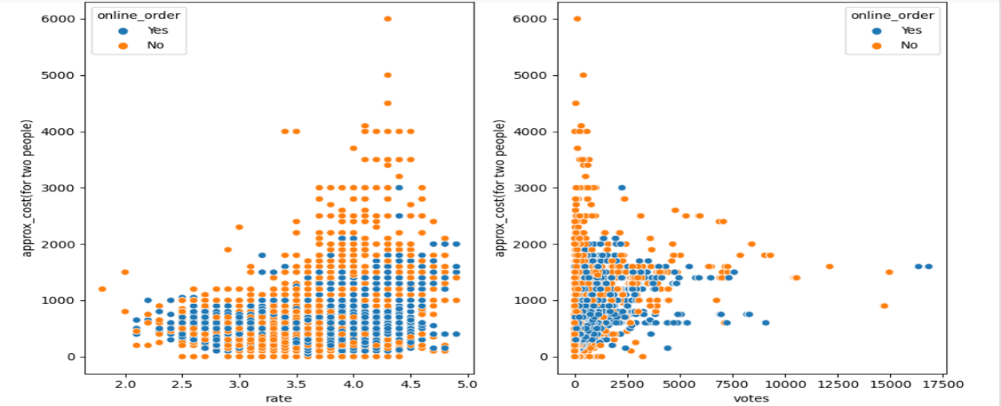
There is a positive co-relation between rating and approximate cost based on the table booked.
There is positive co-relation between rating and approximate cost based on online orders.

Slide 17
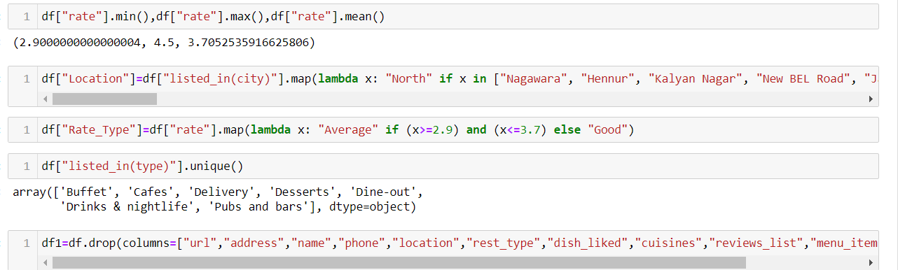
Feature Extraction:
Feature Location categorized into North, South, East ,West
The variable rate type is based on the rating of the customers.
There are seven different styles of services from listed type.
We will drop the columns which are insignificant for model.

Slide 18
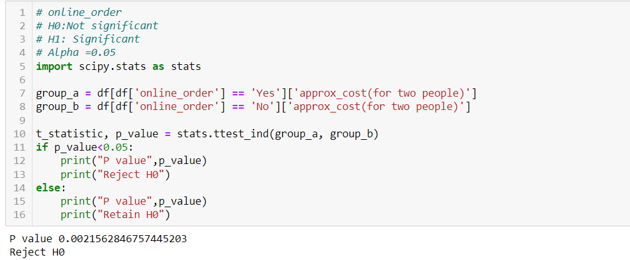
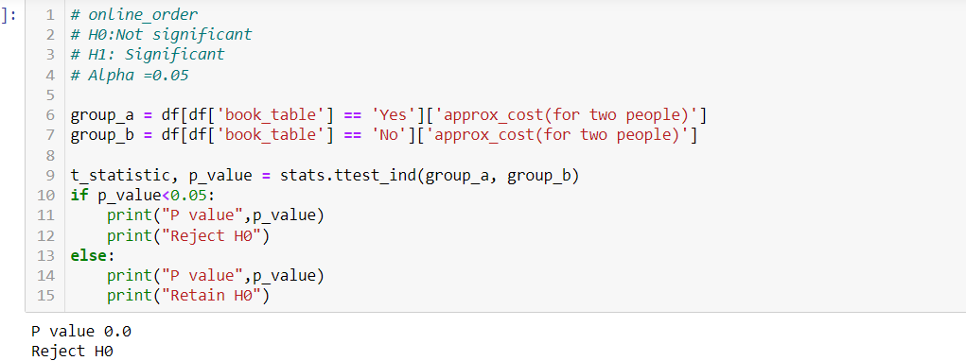
Statistical Testing:
The test which is used to get the significant variable with dependent variable.
H0 : online order is not significant
H1 : online order is significant
Since the p-value is < 0.05, we reject null hypothesis.
H0 : book table is not significant
H1 : book table is significant
Since the p-value is < 0.05, we reject null hypothesis.

Slide 19
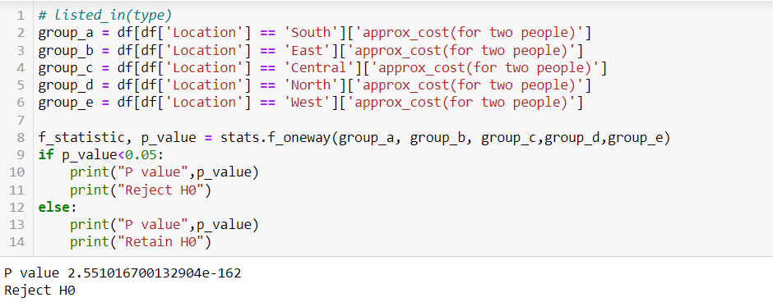
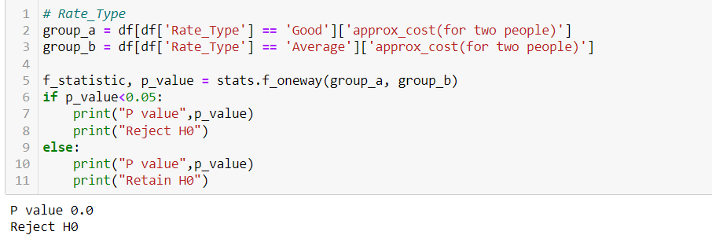
Statistical Testing:

Slide 20
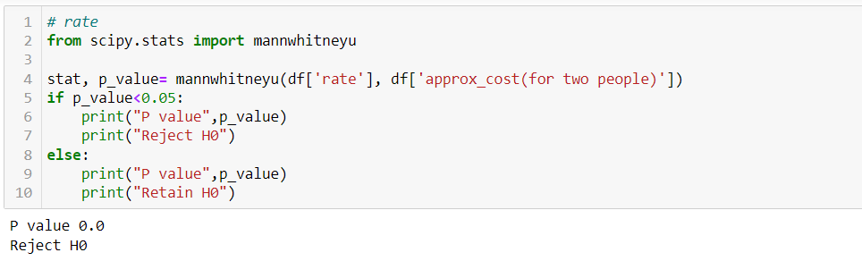
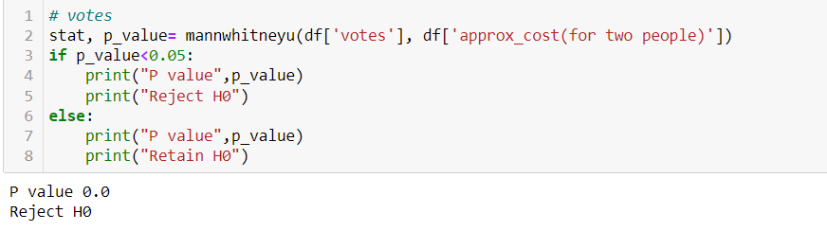
Statistical Testing:
All the columns are significant with respect to the target as per the statistical tests.

Slide 21
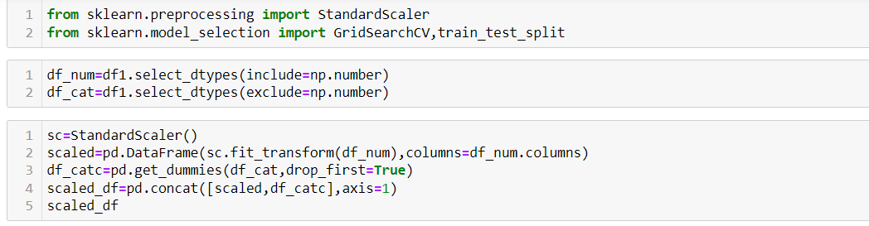
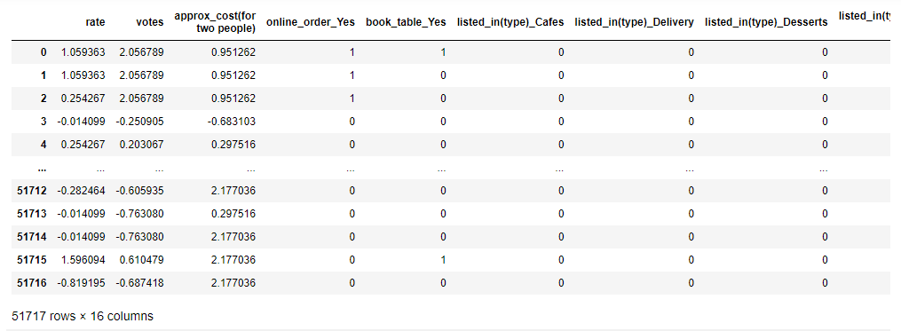
Scaling and Encoding:
Data has been separated into numeric and categorical.
We have used standard scalar from scikit learn library.
After scaling data split into train and test set.

Slide 22
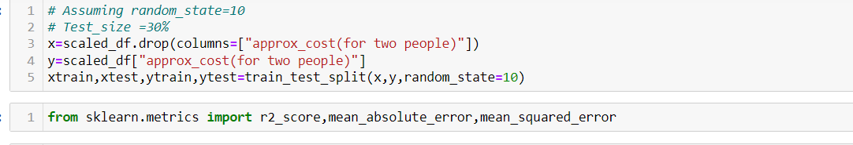
Splitting Data into train and test:
Here we split into train and test data with target variable of approximate cost.

Slide 23
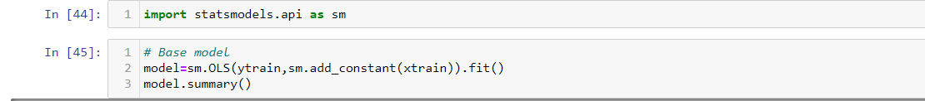
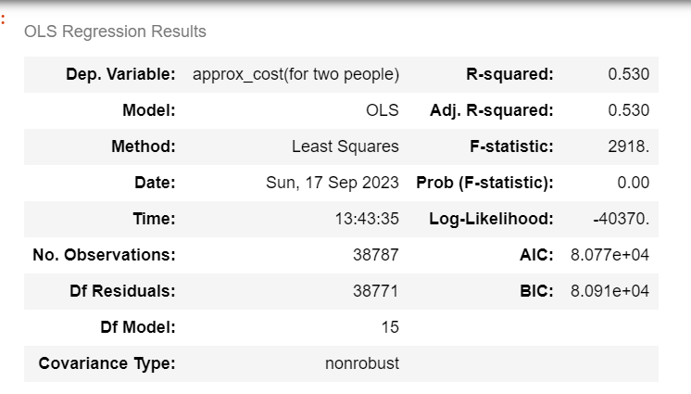
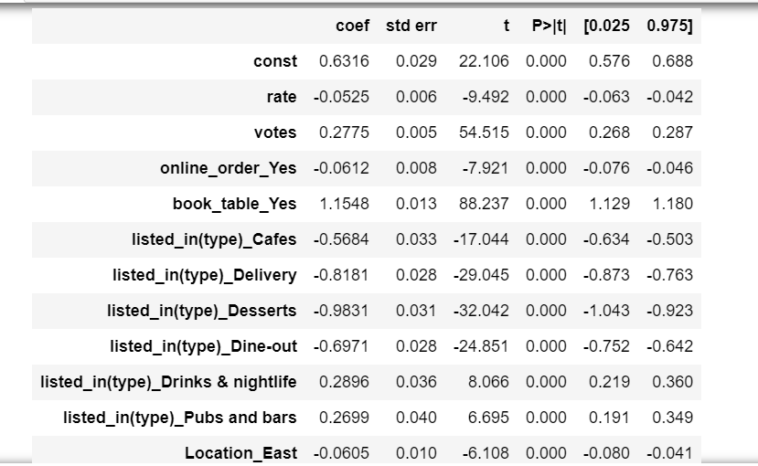
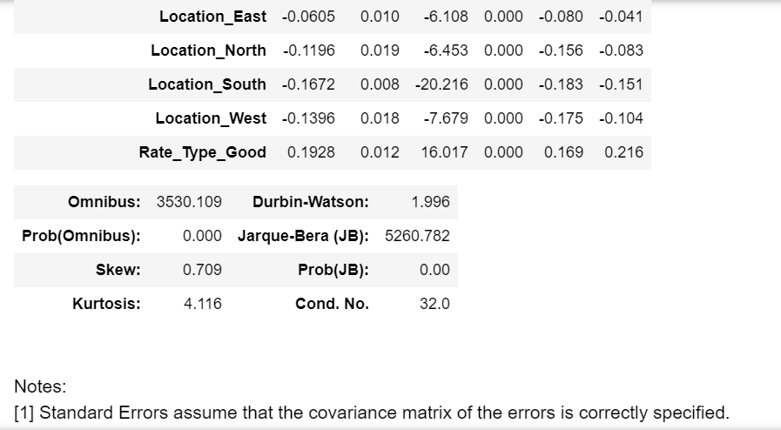
Base Model

Slide 24
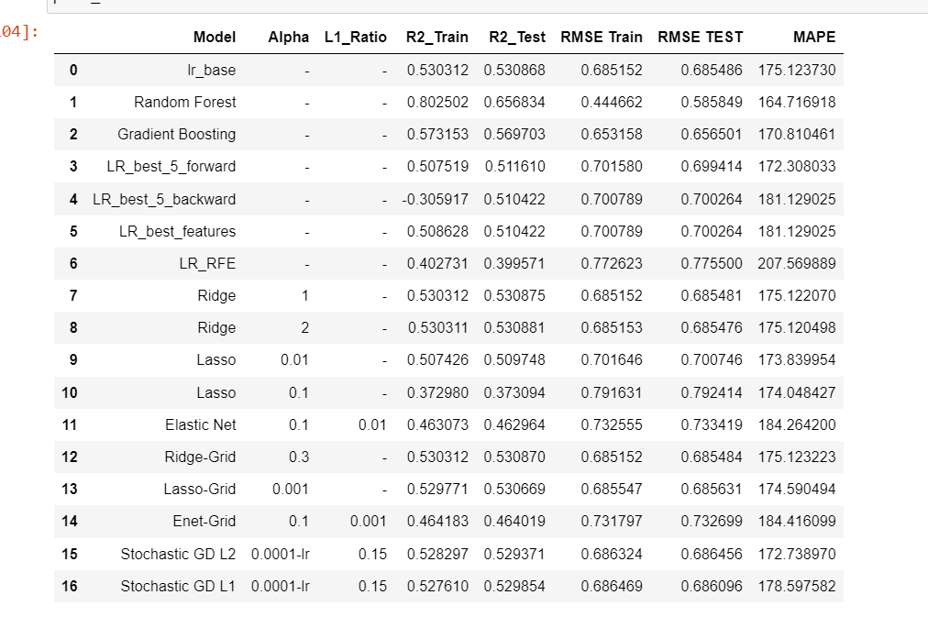
Conclusion
The best model is the random forest regressor.

Slide 25
Classification
Objective:
The Aim is to classify the orders that have been ordered online and offline. And identify the patterns that lead to orders online orders as well as offline.
Target column - Online Order/ Offline Order

Slide 26
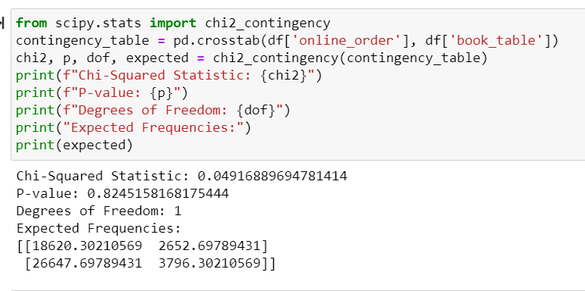
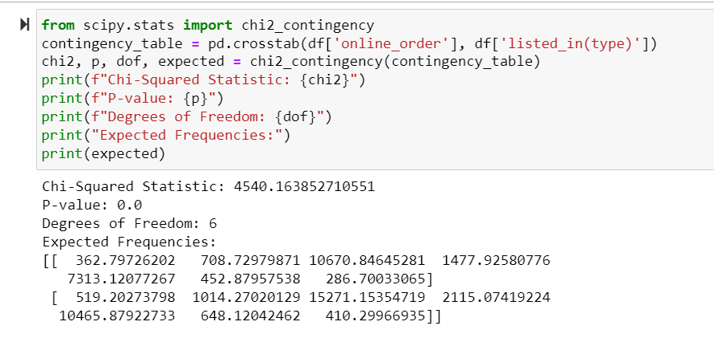
Statistical Testing:
Here we have used chi2_contingency, Since the variables are categorical.
It is used to show significant relation between two categorical variables.

Slide 27
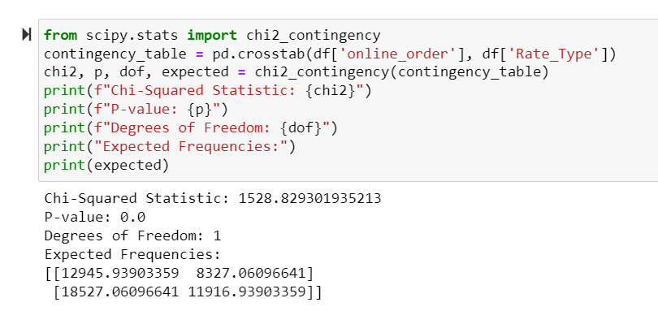

Statistical Testing
Same chi2-contingency test is performed for the variables rate type and location.

Slide 28

Scaling and Encoding:
We have used standard scalar from scikit learn library.
After scaling data split into train and test set.

Slide 29


The target variable which is converted to 0 and 1 to perform logistic regression.

Slide 30

Target column
Since the data is balanced we need to look at accuracy score

Slide 31

Splitting Data into train and test and Base Model
Here we split into train and test data with target variable of approximate cost.
And here the target variable is online order.

Slide 32

Logistic Regression:
Pseudo R_square is 13%
Loglikelihood of the model is close to loglikelihood of the null model.
Most of the columns are significantly contributing to the model except for location_north and location_west

Slide 33

Conclusion
The best model is AdaBoost with Decision Tree.
Since it is giving the highest accuracy score 78.9%

Slide 34
PRESENTED BY:
ADARSH B
ALKA CHAUHAN
DINESH S
SREEDEVI K
GAGAN

Slide 35


